Slide 1
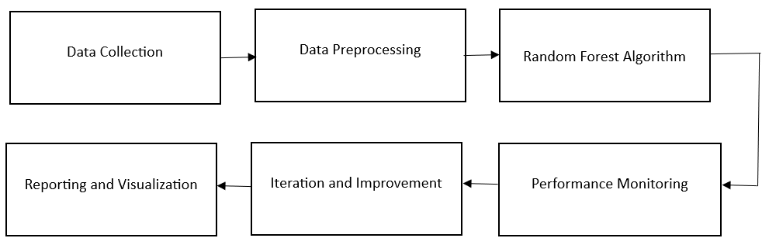
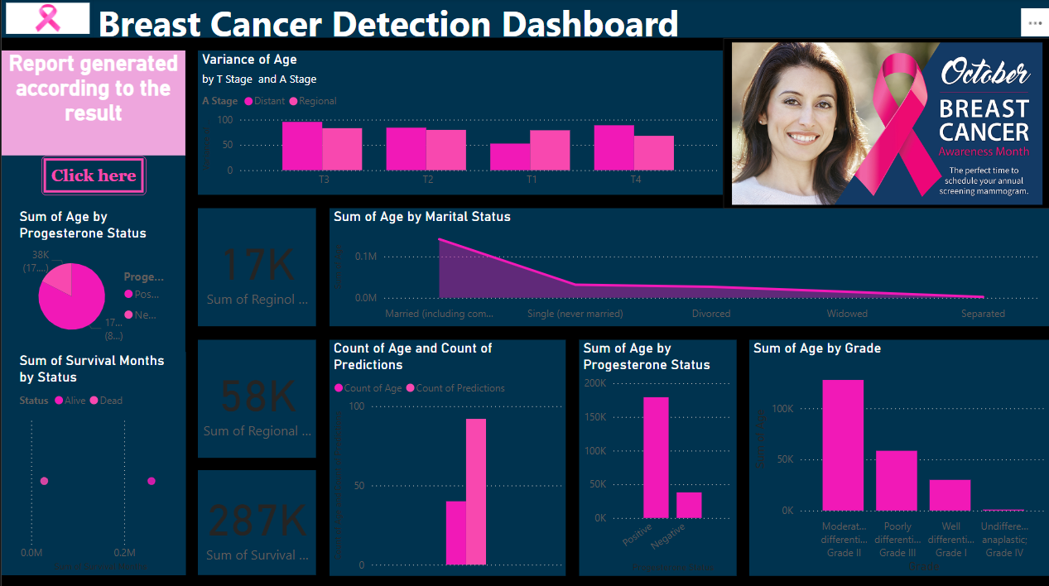
5th International Conference on Advanced Technologies for Societal Applications
Techno Societal 2024 Paper/Poster ID:473
Stream:CSE(Computer Science and Engineering)
Discipline:Engineering
Title :Enhancing Breast Cancer Diagnosis Through Predictive Analytics
Objectives:
Facilitate seamless CSV file uploads to Power BI for efficient data management.
Develop a Google colab workflow to process data, train a Random Forest model, and integrate predictions into the dataset.
Implement an automated system to refresh Power BI dashboards with updated data and predictions for immediate insights.
Services Provided by the Application:
Offer interactive visualizations for insights into diagnosis trends and patient outcomes.
Enable real-time updates and reporting for improved clinical decision-making and patient care.
Utilize machine learning algorithms to predict breast cancer risk based on patient data.
Target Audience:
Oncologists and medical providers using diagnostic tools.
Data scientists focused on cancer analytics.
Individuals and organizations seeking improved outcomes.
Algorithm:
Random forest algorithm
Google colab
Powerful BI
Flow Chart:
Our application in real-time:
Conclusion:
The project on enhancing breast cancer diagnosis through predictive analytics represents a significant advancement in leveraging data-driven approaches for improved healthcare outcomes. By utilizing machine learning algorithms, incorporating diverse data sources, and focusing on user-centric design, the application aims to empower healthcare professionals and patients alike.
The ongoing commitment to algorithm refinement and the development of intuitive interfaces will ensure that this project continues to provide valuable insights and support informed decision-making in breast cancer diagnosis and management.
Plans for Future:
Future plans to enhance our project by developing more sophisticated algorithms to improve prediction accuracy and robustness in breast cancer diagnosis. We will expand our data sources to include diverse datasets, incorporating genetic and lifestyle factors, which will help refine risk assessments and provide deeper insights. Additionally, we aim to create user-centric features by developing user-friendly interfaces and mobile applications, enabling healthcare professionals and patients to easily access analytics and insights for better decision-making and improved patient outcomes.

